Slide 1


FreelanceGig Analytics

Slide 2



01
Capstone Project
Comprehensive Analysis of the Gig Economy
02
03
Using Tableau

Slide 3






Business Introduction
There are three key stages to examine
01
Analysis
FreelanceGig Analytics analyses trends in the gig economy.
02
Freelancers
03
The company focuses on freelancer earnings, job performance, and market demand.
Insight
Provides insights for freelancers, businesses, and policymakers.

Slide 4










Problem Statement
Freelancers and clients often struggle to predict:
01
02
03
04
05
Earnings potential
Job success rates
Demand for skills
Marketing Tools
Forecasting
Enable freelancers discover their earning powers.
The importance of customer satisfaction.
Discovery of diverse earning power.
How marketing tools help to unlock more earnings.
Predicting the future in the freelancing space.

Slide 5
Project Objectives
Analyse freelancer job trends
01
02
Assess freelancer earnings
03
Identify key success factors
04
Forecast freelancer earnings
Develop an interactive Tableau dashboard
05

Slide 6
Key Performance Indicators (KPIs)
Total
Earnings
Marketing Spend and Earnings by Job Category
Average hourly rate by experience level
01
04
Average Job
Success Rate
07
10
02
05
Average Client Rating
08
11
Total Jobs
Completed
Job category by earning
Earnings by region
03
06
Rehire Rate
Average
Hourly Rate
09
Job success rate
by platform

Slide 7





Earnings by Job Category
Job Success Rate by Platform
Earnings by Client Region &
Marketing Spend vs Earnings
Hourly Rate by Experience Level
Dashboard Analysis
The dashboard provides the following insights

Slide 8
The result aggregates high‑level performance indicators across the entire dataset, including the total number of freelancers, jobs completed, earnings, ratings, job success, and rehire rates.
The platform ecosystem is large, with 1,950 freelancers completing 294,000 jobs, indicating strong marketplace activity.
Total earnings reached $10M, with an average hourly rate of $53/hour, suggesting freelance work is financially competitive.
Average client rating of 4/5 reflects generally positive client satisfaction. 74.95% job success rate indicates most gigs are completed successfully. 45% rehire rate signals moderate client loyalty but room for improvement.
The gig economy shows strong volume and healthy earnings, but retention (rehire rate) could be improved to stabilise freelancer income.
Total freelancers
Total jobs completed
Total earning
1950
294,000
$10M
Key insights Scale:
Earnings strength:
Average hourly rate
Average job success rate
Average client rating
$53
74.95%
4
Quality indicators:
Summary of KPI’s
Average rehire rate
Average job duration
45%
44.70
Summary takeaway

Slide 9
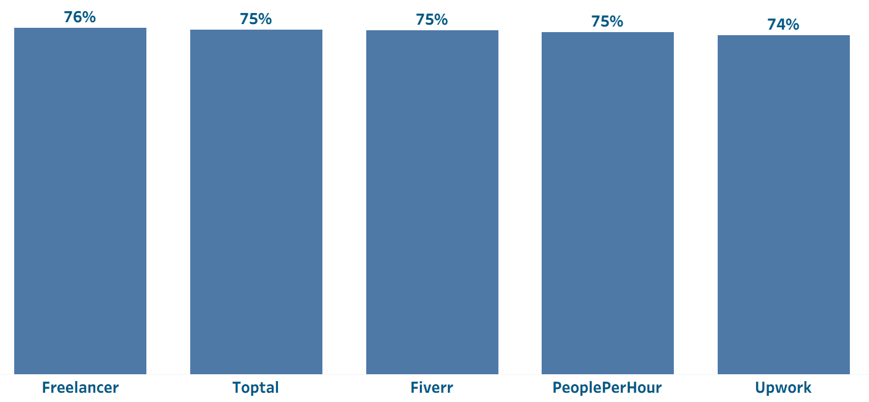
Success Rate by Platform
The chart compares job success rates across different freelancing platforms.
Key insights: Freelancer has the highest success rate at 76%, suggesting better job matching or job opportunities. Toptal, Fiverr, and PeoplePerHour platforms cluster closely around 75%, indicating similar effectiveness. Upwork records the lowest success rate at 74%, though the difference is marginal.
Interpretation: Differences are small, meaning platform choice alone does not strongly determine success. Slight variations may reflect platform policies, job screening, or client quality.
Summary: All platforms perform similarly, but small success‑rate differences may influence freelancers’ platform choice when competition is tight.

Slide 10
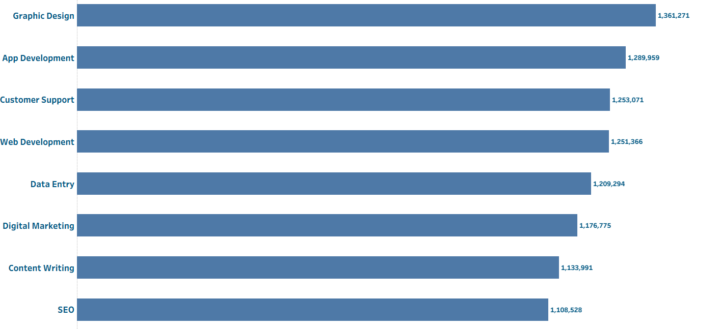
Job Category by Earning
The chart ranks job categories by total earnings generated.
Key insights:
Graphic Design earns the most (≈ $1.36M), making it the most lucrative category. SEO generates the lowest earnings (≈ $1.11M). Earnings differences suggest uneven market demand and pricing power across skills. High‑earning categories likely combine strong demand + scalable deliverables. Lower‑earning categories may be more competitive or undervalued.
Summary:
Freelancers targeting high‑earning categories (like graphic design) have better income potential than those in oversaturated or lower‑value roles.

Slide 11
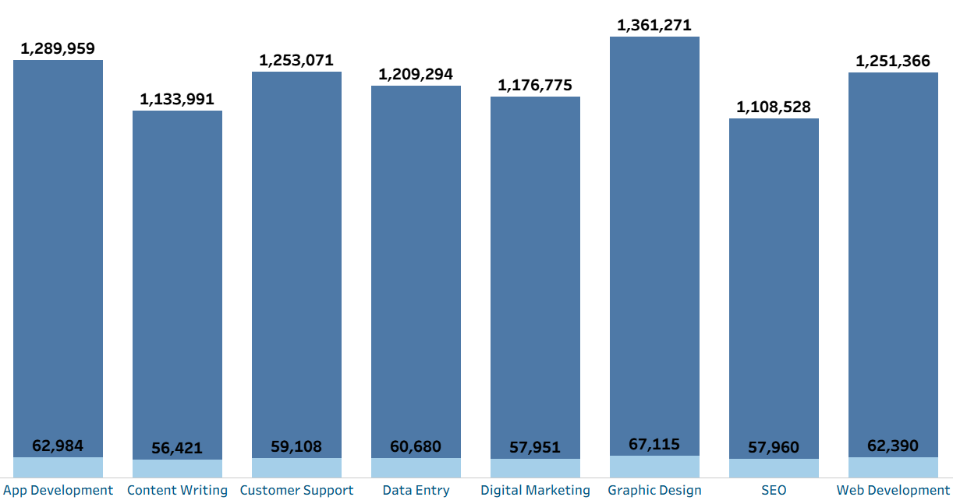
Marketing Spend and Earnings by Job Category
The chart compares marketing investment against earnings across job categories.
Job categories with higher marketing spend also report higher earnings.
Graphic Design shows both high marketing investment and high returns. Low marketing spend does not consistently lead to low earnings.
Marketing increases visibility, client reach, and job opportunities. The relationship is positive but not perfectly proportional, meaning marketing must be strategic.
Marketing spend is a powerful income driver, but effectiveness depends on how and where it is applied.
Key insights:
Summary:

Slide 12
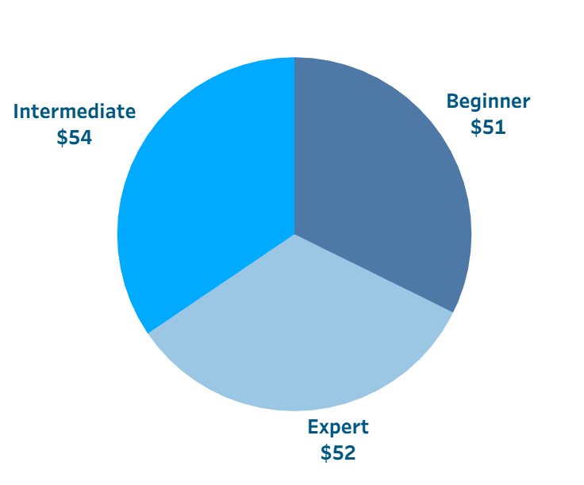
Hourly Rate by Experience Level
The chart compares the average hourly earnings of freelancers across the three experience levels: beginner, intermediate, and expert.
Intermediate freelancers earn the highest average rate of $54/hour. Experts earn slightly less ($52/hour), and beginners earn $51/hour. The differences are narrow, indicating experience alone does not dictate pricing power.
Intermediate freelancers may balance competitive pricing with proven experience, making them more attractive to clients. Experts may accept lower rates to remain competitive or secure more consistent work.
Optimal earnings occur at the intermediate level, suggesting that marketability may matter more than expertise.
Key insights:
Summary:

Slide 13
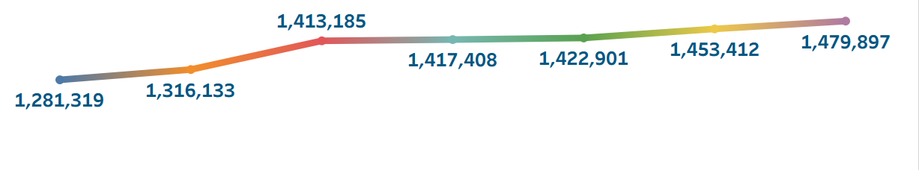

Earnings by Region
The chart shows the total earnings by client’s geographical region.
Australia records the highest earnings (~$1.48M). Europe shows the lowest earnings (~$1.28M). Differences indicate varying labour demand, wage standards, and market maturity.
Regions with higher earnings may offer better‑paying clients or fewer freelancers per job.
Regional targeting can significantly influence income outcomes.
Freelancers who target clients in high‑earning regions can substantially increase their earning potential.
Key insights:
Summary:

Slide 14
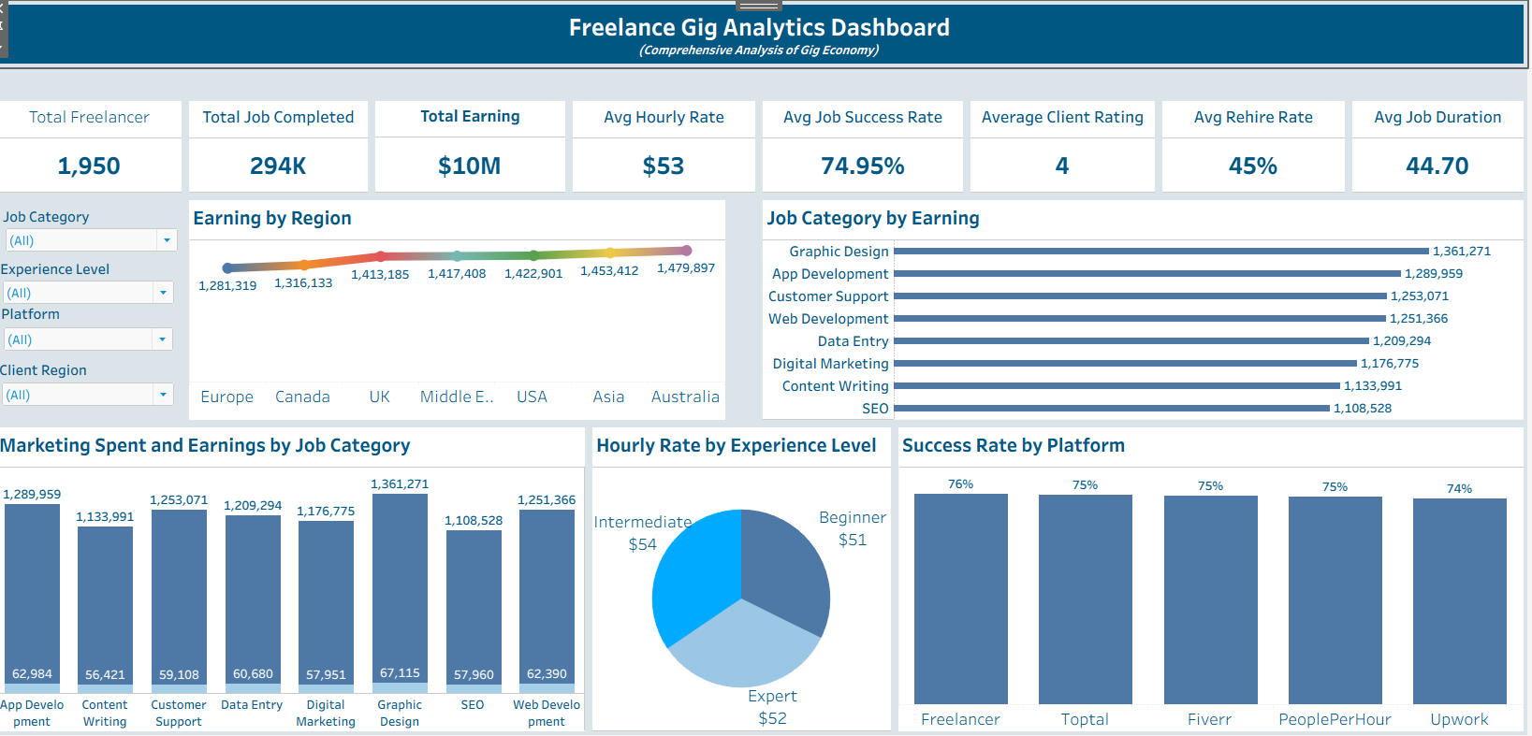
Dashboard

Slide 15
Forecasting
SUMMARY OUTPUT
Regression Statistics
Multiple R | 0.073789246
R Square | 0.005444853
Adjusted R Square | 0.001859948
Standard Error | 2923.557287
Observations | 1950
ANOVA
 | df | SS | MS | F | Significance F
Regression | 7 | 90871923.14 | 12981703.31 | 1.518827537 | 0.15624711
Residual | 1942 | 16598637568 | 8547187.213
Total | 1949 | 16689509491
 | Coefficients | Standard Error | t Stat | P-value | Lower 95% | Upper 95% | Lower 95.0% | Upper 95.0%
Intercept | 4181.282277 | 638.0528205 | 6.553191432 | 7.19413E-11 | 2929.94183 | 5432.623 | 2929.942 | 5432.623
Hourly_Rate | 1.643140251 | 2.465321533 | 0.666501399 | 0.50516984 | -3.1918145 | 6.478095 | -3.19181 | 6.478095
Job_Success_Rate | 6.025211278 | 4.536428349 | 1.32818394 | 0.184273418 | -2.8715698 | 14.92199 | -2.87157 | 14.92199
Client_Rating | 96.474699 | 115.1658425 | 0.837702368 | 0.402300965 | -129.38697 | 322.3364 | -129.387 | 322.3364
Job_Duration_Days | 1.051520774 | 2.549743418 | 0.412402584 | 0.68008989 | -3.9490011 | 6.052043 | -3.949 | 6.052043
Job_Completed | -0.63701893 | 0.775712522 | -0.82120491 | 0.411630359 | -2.1583357 | 0.884298 | -2.15834 | 0.884298
Rehire_Rate | -5.881583956 | 3.288759999 | -1.78838953 | 0.073869023 | -12.331455 | 0.568287 | -12.3315 | 0.568287
Marketing_Spend | 0.901127562 | 0.448505121 | 2.009180093 | 0.044656183 | 0.02152546 | 1.78073 | 0.021525 | 1.78073
The Forecasting Table using Regression Statistics.

Slide 16
Interpretation
Based on the Regression Table: Regression model tested multiple predictors of earnings (hourly rate, success rate, ratings, duration, rehire rate, marketing spend).
Adjusted R² (≈ 0.005) is very low, showing weak model fit.
Significance F > 0.05 → model is unreliable
Marketing Spend is the only statistically significant variable (p < 0.05)

Slide 17
Regression Table & Forecasting
SUMMARY OUTPUT
Regression Statistics
Multiple R | 0.043041301
R Square | 0.001852554
Adjusted R Square | 0.001340158
Standard Error | 2924.318422
Observations | 1950
ANOVA
 | df | SS | MS | F | Significance F
Regression | 1 | 30918210.77 | 30918210.77 | 3.615472254 | 0.057391888
Residual | 1948 | 16658591280 | 8551638.234
Total | 1949 | 16689509491
 | Coefficients | Standard Error | t Stat | P-value | Lower 95% | Upper 95% | Lower 95.0% | Upper 95.0%
Intercept | 4806.194265 | 129.394673 | 37.14367952 | 8.8138E-229 | 4552.427694 | 5059.961 | 4552.428 | 5059.961
Marketing Spend | 0.850533487 | 0.447310302 | 1.901439522 | 0.057391888 | -0.026723662 | 1.727791 | -0.02672 | 1.727791
From the Regression Table:
Marketing spend has a direct, measurable impact on earnings growth. Marketing spend is the strongest earnings predictor, but freelancer success depends on many unmeasured qualitative factors.
To calculate the Earnings (USD) when the Average Marketing Spend is $248.5,
= (Coefficient of Marketing Spend *248.5) + Intercept,
= $5,017.6.
Irrespective of the career, the higher the Marketing Spend, the higher the Earnings.
The Forecasting Table using Regression Statistics.

Slide 18




Conclusion
Category
Performance
Opportunity
Support
Freelancer earnings vary widely across categories, regions, and experience levels.
Graphic design emerged as the highest‑earning job category.
Maintaining high client ratings and job success rates increases the likelihood of repeat work and long-term success for freelancers.
Overall, the dashboard demonstrates that strategic marketing, skill development, and strong client relationships are key drivers of success in the freelance marketplace.
Australia recorded the highest regional earnings.
Intermediate freelancers earned the highest average hourly rate.
These insights can help freelancers, businesses, and policymakers make better decisions and improve opportunities within the growing gig economy.

Slide 19



Recommendations
Maintain High Client Satisfaction
Increase Investment
in Marketing
Focus on High-Earning Job Categories
Target High-Performing Regions
Improve Skills and Professional Experience
Strengthen Platform Performance

Slide 20
Further Recommendations
Based on our analysis, freelancers should focus on high‑earning job categories, especially graphic design, which consistently generates the highest earnings. Marketing spend stood out as the strongest driver of income, so freelancers should invest in profile promotions, portfolio visibility, and advertising tools. Additionally, targeting higher‑earning regions such as Australia can significantly improve earning potential without increasing workload. Finally, maintaining strong job success rates and ratings is essential to improve rehire rates and ensure steady income.”
Freelancers
For freelancing platforms, the data suggests a need to improve marketing and analytics tools. Since marketing spend has a measurable impact on earnings, platforms should provide clearer insights into how promotions translate into income. Improving matching algorithms can also help, as success rates vary slightly between platforms. Better matching increases job completion and user satisfaction. Lastly, platforms should support intermediate‑level freelancers, as this group showed the highest hourly earnings and strong market demand.”
Freelancing
Platforms
For clients and businesses, the findings suggest prioritising investment in high‑performing categories like graphic design to maximise value. Working with freelancers who have strong ratings and success rates reduces project risk and improves outcomes. Encouraging long‑term engagements rather than one‑off jobs can also improve consistency, quality, and overall project efficiency.
Clients and
Businesses
Our forecasting analysis revealed that the regression model had limited explanatory power, mainly due to missing variables. Future analysis should include qualitative factors such as freelancer skills, certifications, portfolio strength, and project complexity. Using more advanced forecasting techniques, such as machine learning or time‑series models, would also improve earnings predictions and support better decision‑making.”
Data & Forecasting Improvements

Slide 21
Thank you.

